Slide 1




Nanoparticle Formation and Deposition during Combustion of Iron Microparticles using Euler-Lagrange Simulations
David Märker¹ Nils Hartmann² Tien Duc Luu¹ Andreas Kronenburg² Oliver T. Stein¹
¹ Engler-Bunte-Institute, Simulation of Reacting Thermo-Fluid Systems, Karlsruhe Institute of Technology
² Institute for Reactive Flows, University of Stuttgart
,
,
,
,

Slide 2
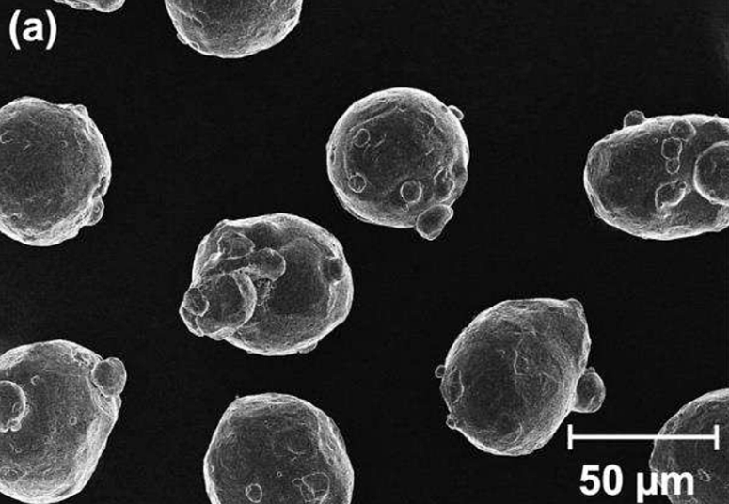
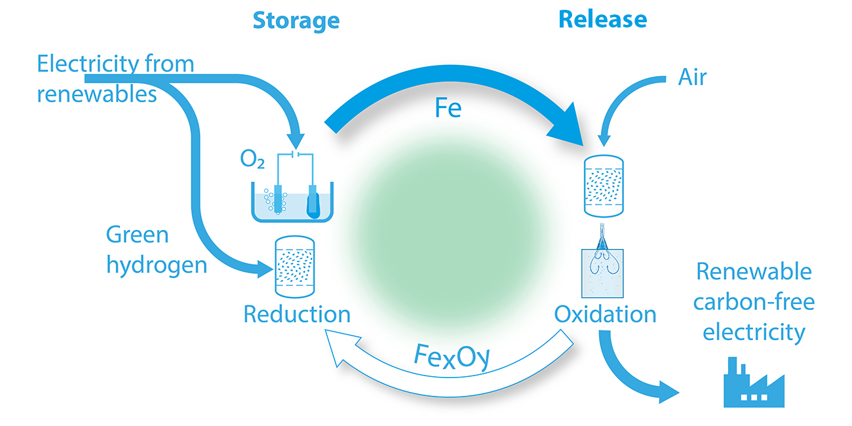
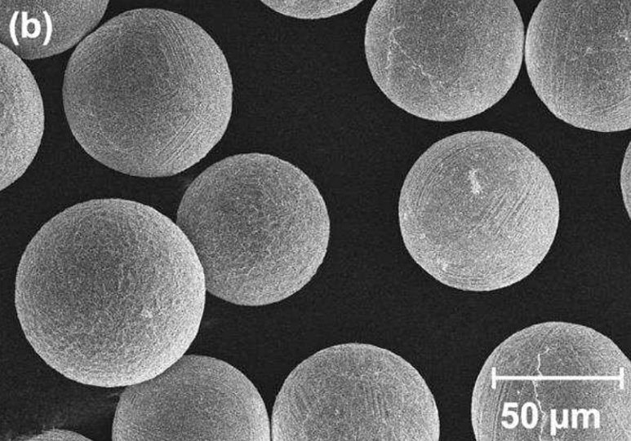
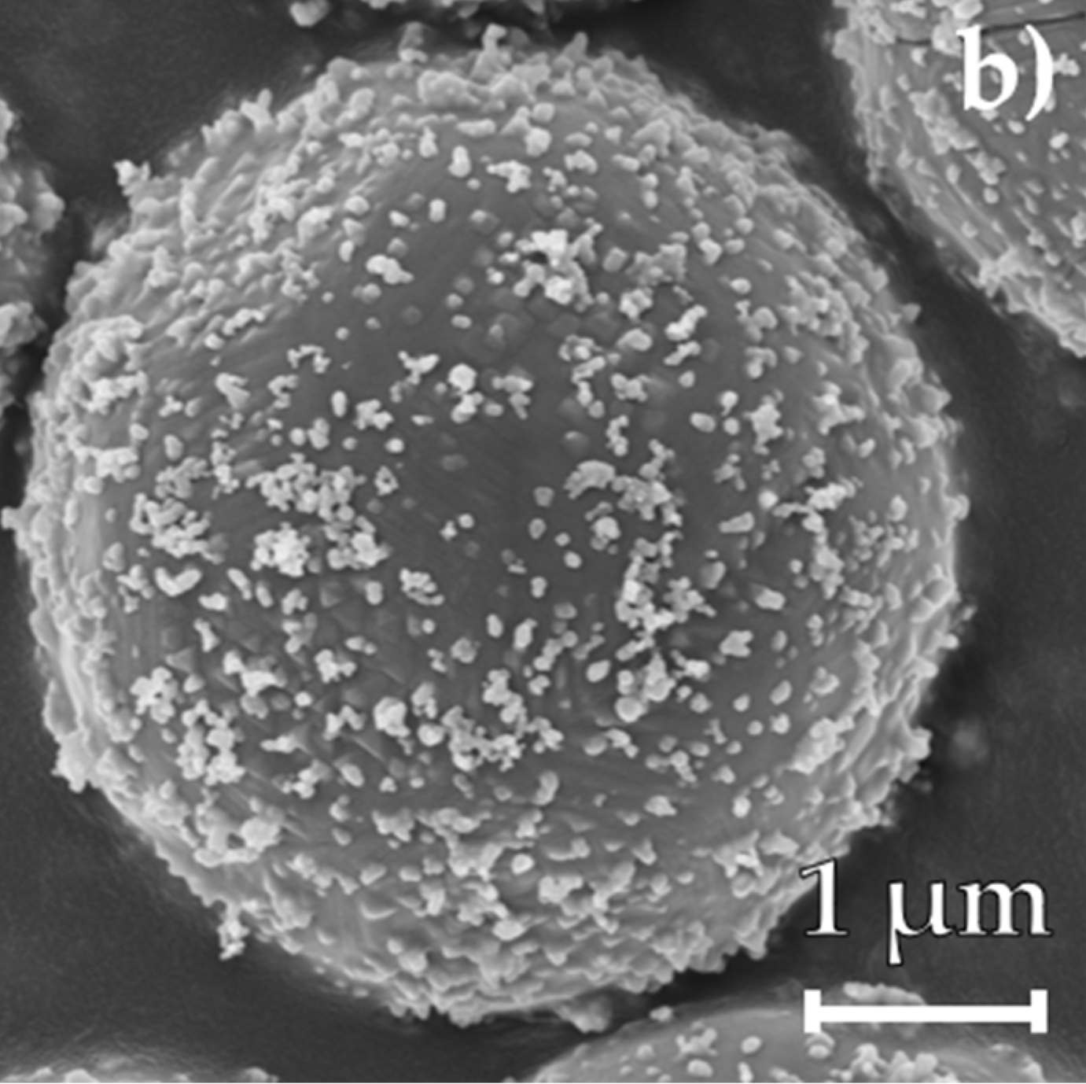
Metal enabled cycle of renewable energies (MeCRE)
[2]
[2]
Nanoparticle Deposition
[2]
[3]
[1]
[1] Hasse, C., et al. (2025) https://www.tu-darmstadt.de/clean-circles/about_cc/index.de.jsp; [2] Chang, D., et al. (2025) Fuel 397: 135366; [3] Buchheiser, S., et al. (2023) Materials 16(5): 2009.

Slide 3
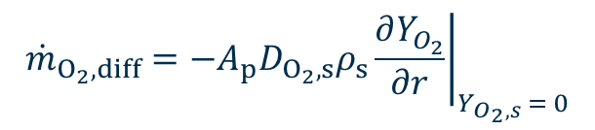



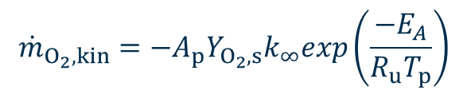
Modelling: Microparticle Oxidation and Nanoparticle Formation
$$d_{p}$$
$$d_{p,0}$$
$${\dot{m}}_{O_{2},kin}=−A_{p}Y_{O_{2},s}k_{∞}exp\left(\frac{−E_{A}}{R_{u}T_{p}}\right)$$
Evaporation
$${\dot{m}}_{Evap}=\frac{{\dot{m}}_{O_{2}}Y_{Fe,s}+A_{p}ρ_{s}Y_{Fe,s}V_{Fe}^{D}}{1−Y_{Fe,s}}$$
O₂
Fe
Fe
Fe
Fe(g)
Collison rate approach
FeO
FeO
Inception
Oxidation
$${\dot{m}}_{O_{2}, diff}=−A_{p}D_{O_{2},s}ρ_{s}{\left.\frac{∂Y_{O_{2}}}{∂r}\right|}_{Y_{O_{2},s} = 0}$$
O₂
Fe(g)
NP
Nanoparticle Transport
Advection
Mass Diffusion
Thermophoresis
Growth
FeO(g)
Nanoparticle Formation
[4] Mich, J., et al. (2023) Combustion and Flame 256: 112949 [5] Nguyen, B.-D., et al. (2025) Chemical Engineering Journal 507: 160039

Slide 4
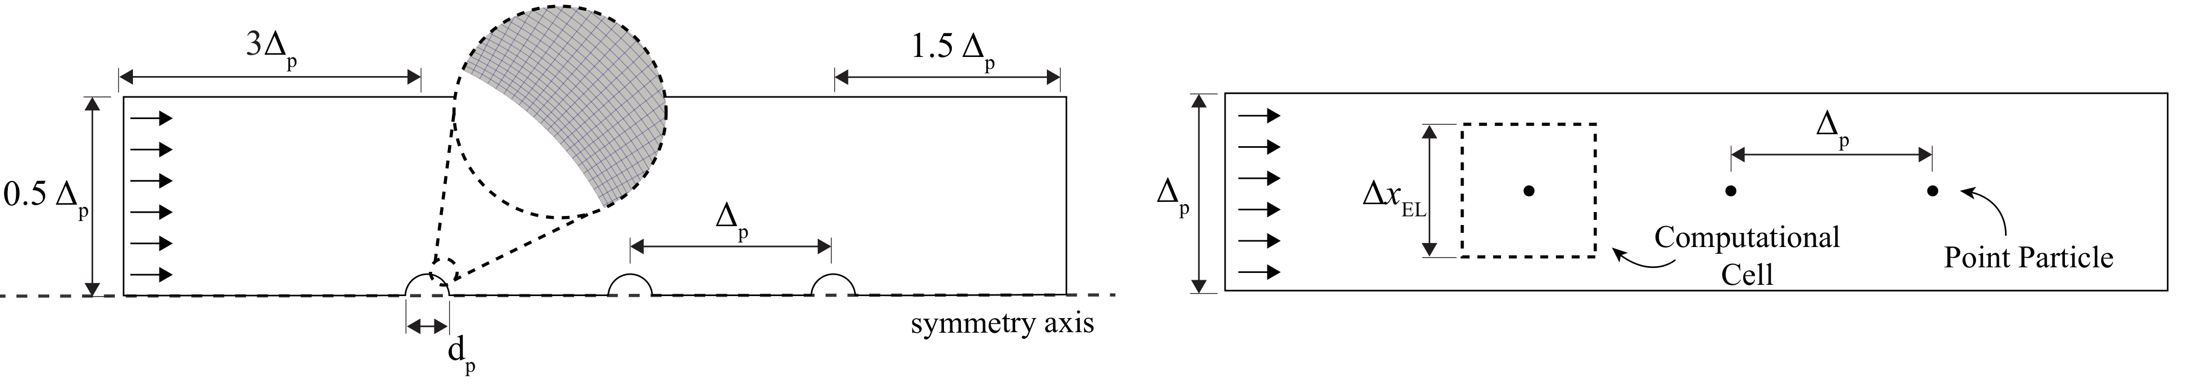
Simulation Approaches
Boundary Layer Resolved
Euler-Lagrange
Precise calculations Computationally expensive Limited scalability
Requires multiple models Computationally Efficient More versatile in terms of scalability
Goal: Make use of the BLRS results to develop models for the unresolved boundary layer in EL
Evaporation Model
Nanoparticle Formation Model
Deposition Model
Oxidation Model
Evaporation Model
Nanoparticle Formation Model
Deposition Model
Oxidation Model

Slide 5
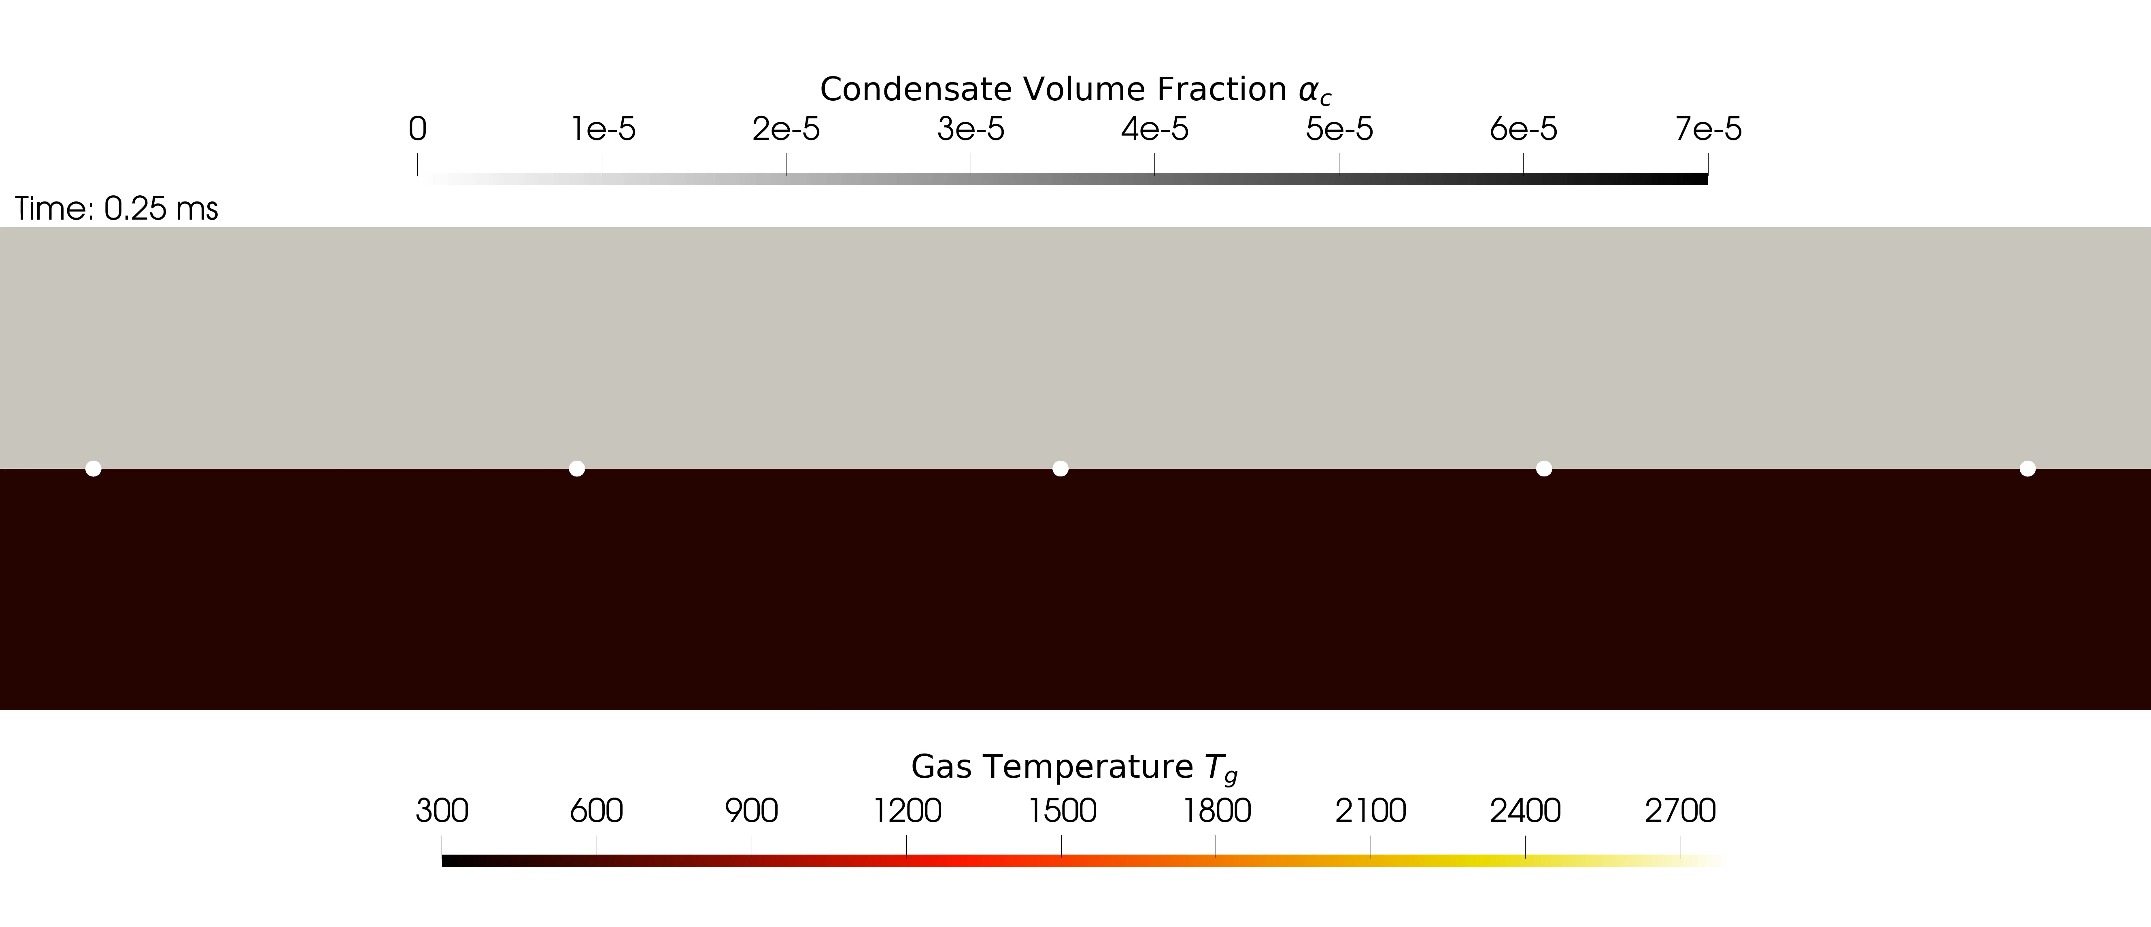
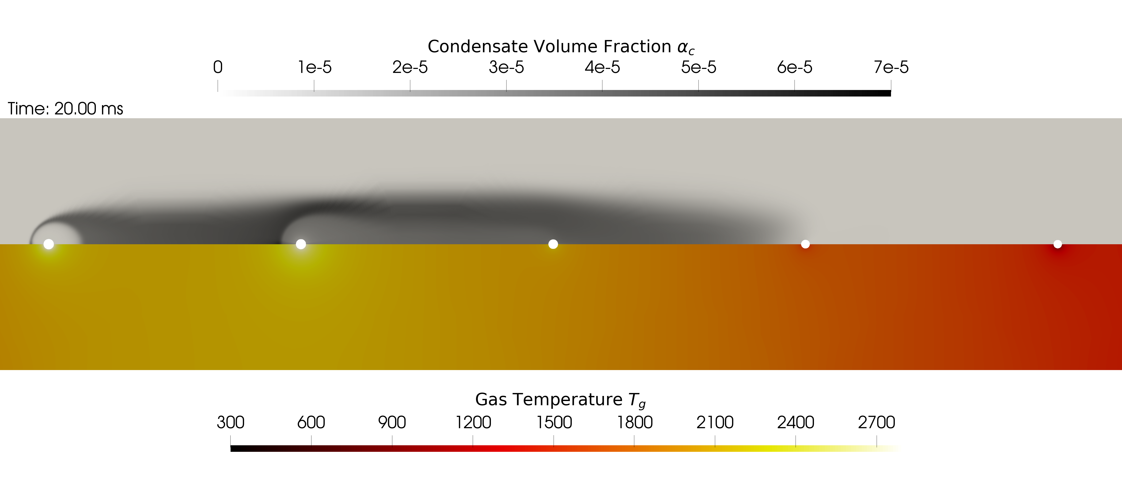


Boundary Layer Resolved Simulation
Video BLRS Multiparticle
$$Δ_{p}=30 d_{p,0}$$
Euler-Lagrange Cell Size
$$d_{p,0}=36 μm$$
Hot Air (1800 K, 0.5 m/s)

Slide 6
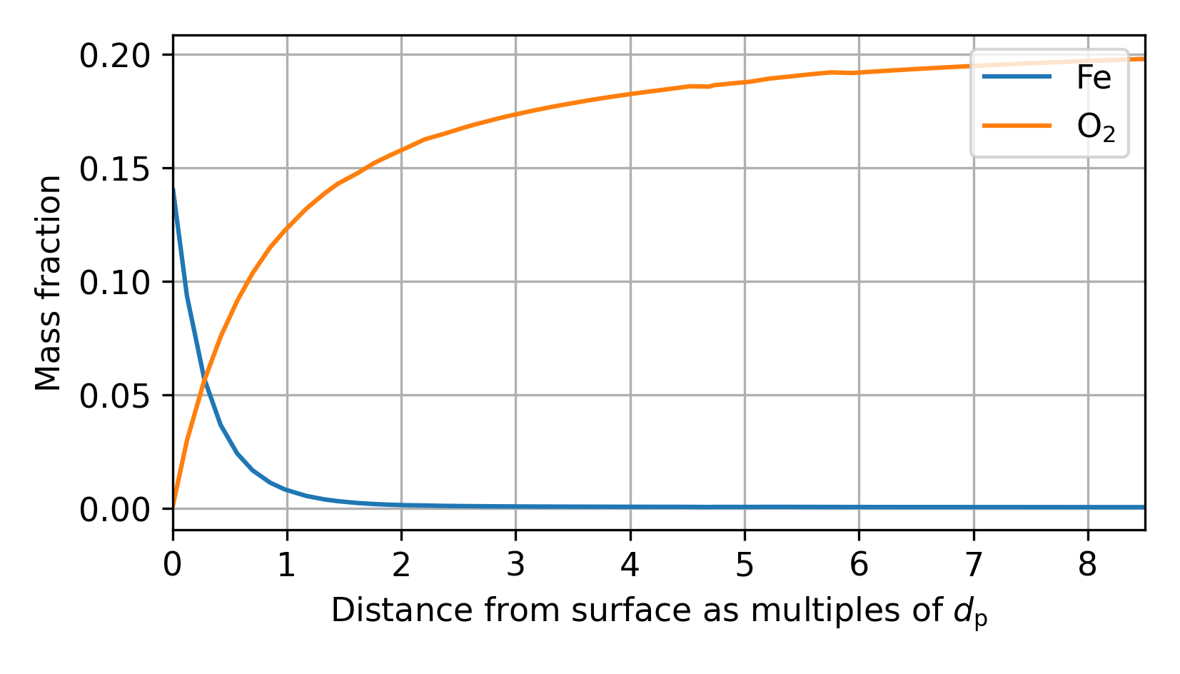
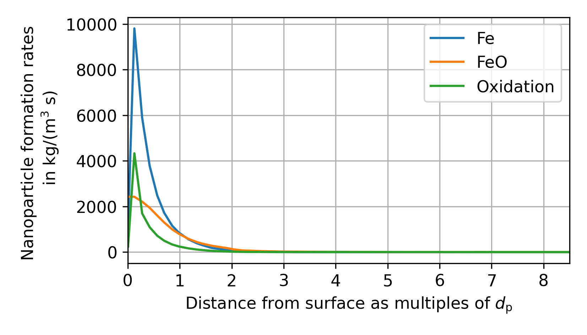
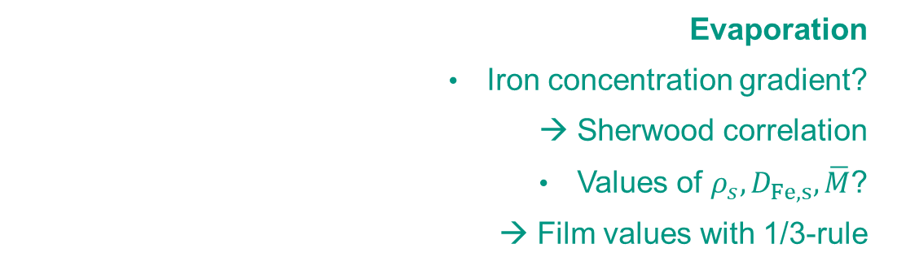

Modelling Boundary Layer Processes: Evaporation and Nanoparticle Formation
Boundary Layer Resolved
Euler-Lagrange
✓
Cell values are known, surface values require modelling
Evaporation
Iron concentration gradient?
→ Sherwood correlation
Values of $ρ_{s},D_{Fe,s},\overline{M}$?
→ Film values with 1/3-rule
?
Fe
$$2d_{p}$$
FeO
Nanoparticle Formation
Happens close to the particle surface
Effect of heat release in the boundary layer?

Slide 7
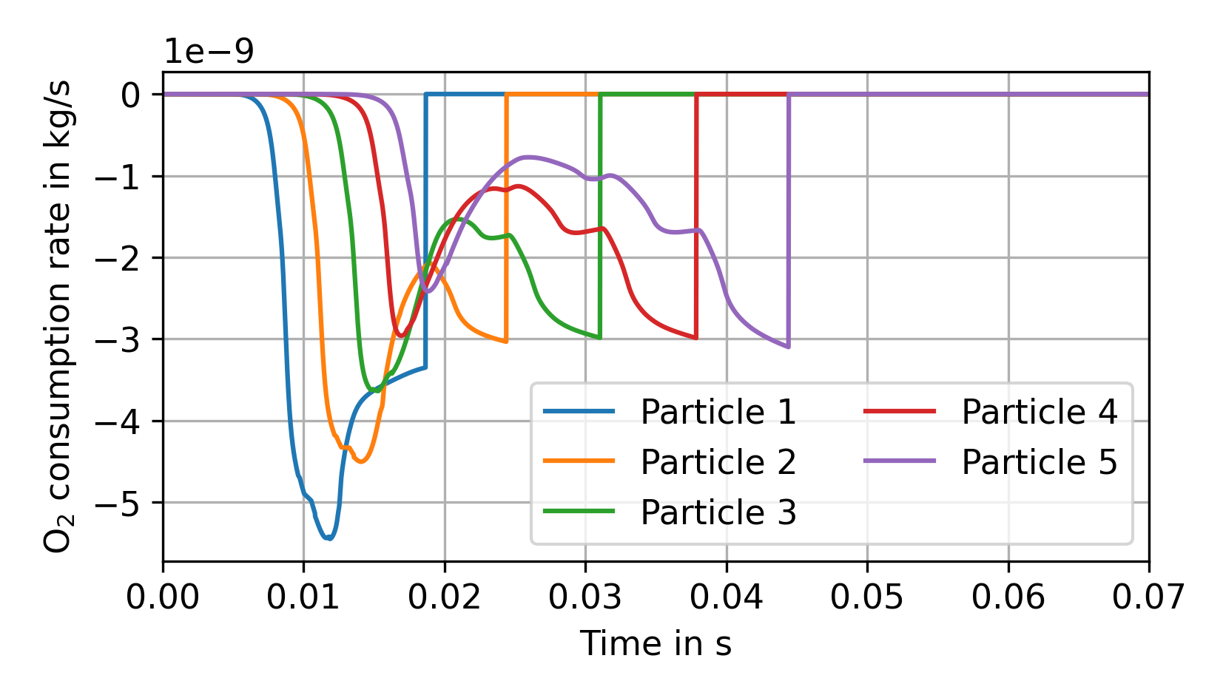
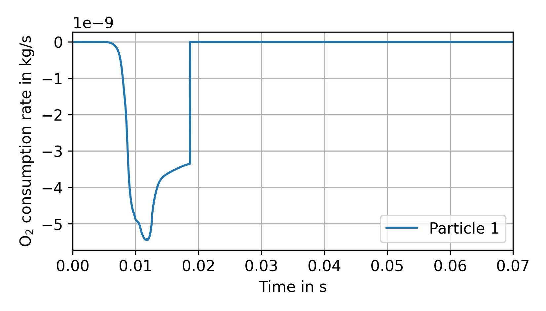
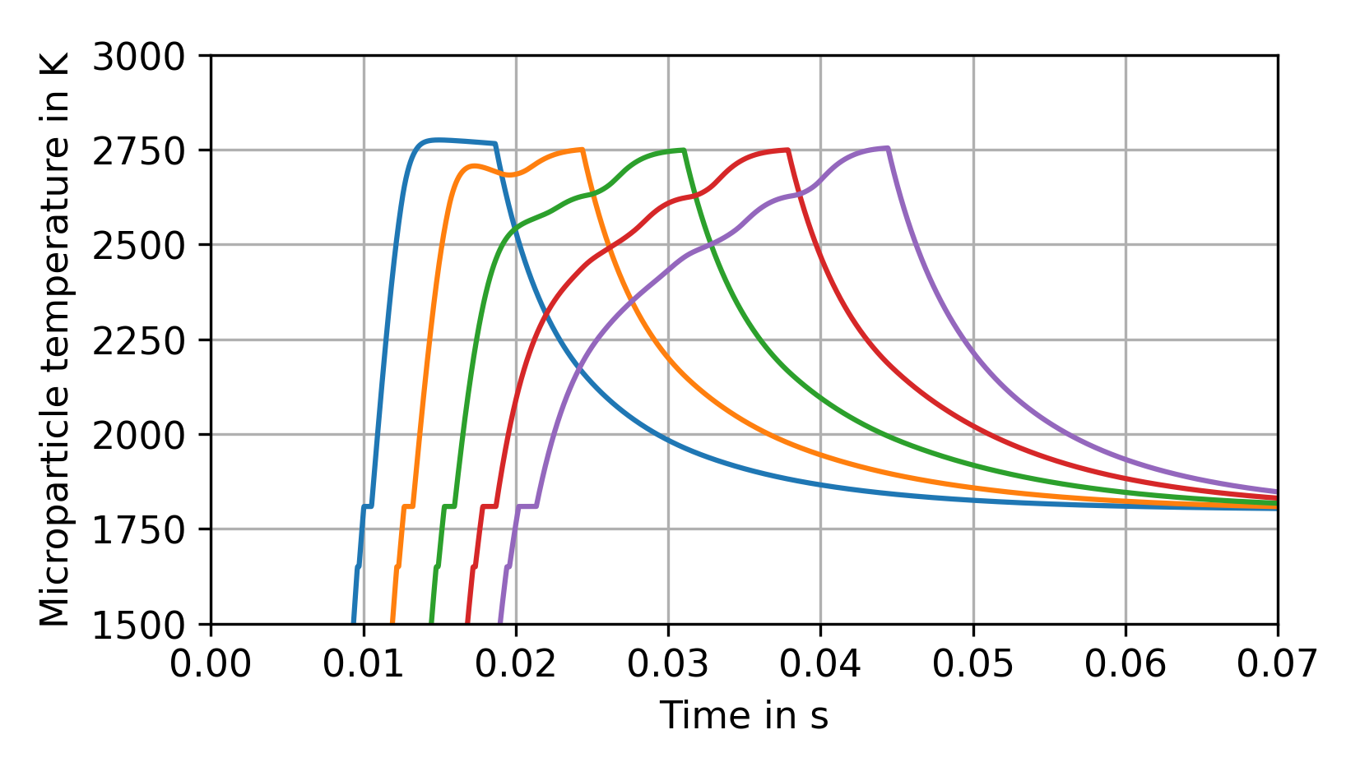
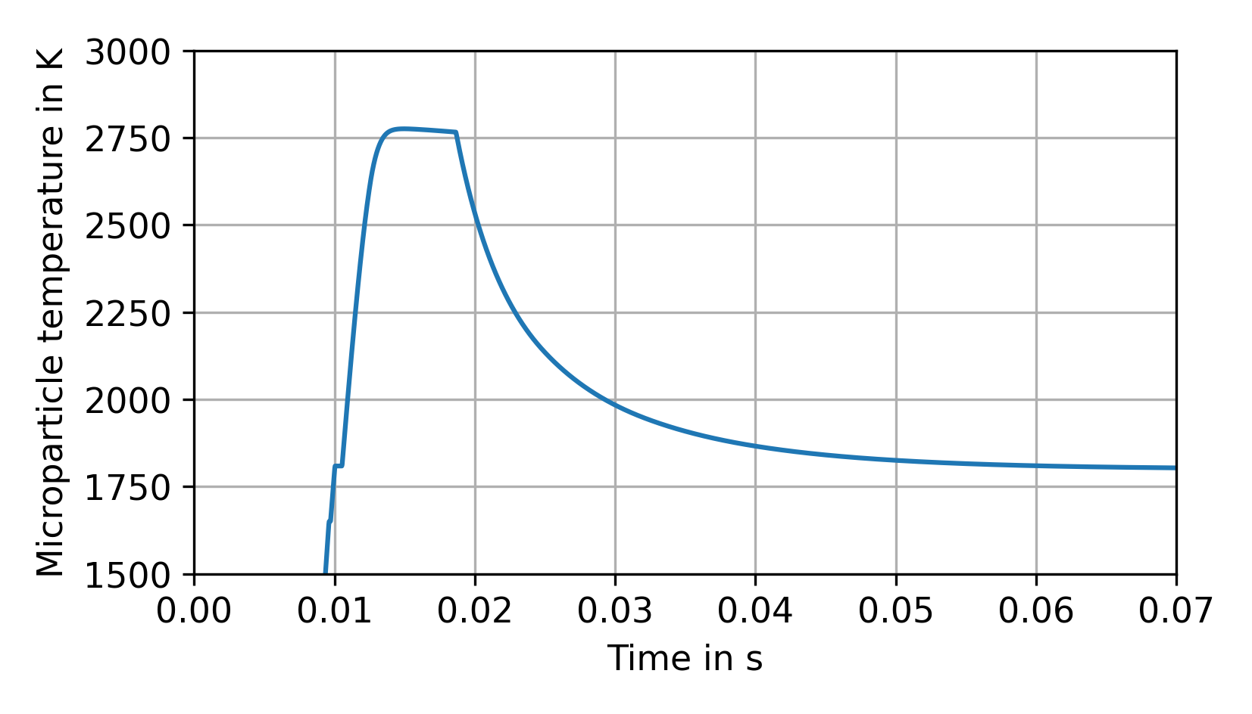
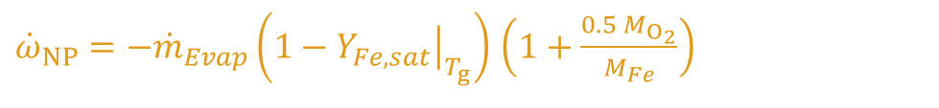
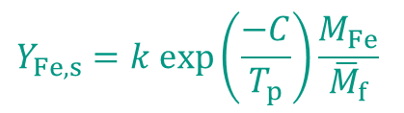
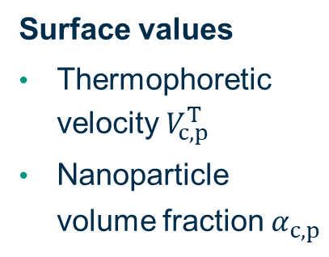

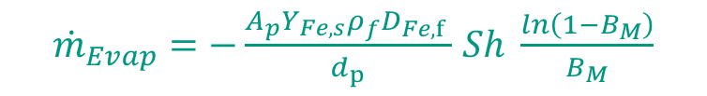

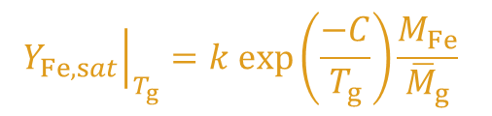
Modelling Boundary Layer Processes: Evaporation and Nanoparticle Formation
${\dot{m}}_{Evap}=−\frac{{A_{p}{Y_{Fe,s}ρ}_{f}D}_{Fe,f} }{d_{p}}$ $Sh \frac{ln\left(1−B_{M}\right)}{B_{M}}$
${\dot{ω}}_{NP}=−{\dot{m}}_{Evap}\left(1−{\left.Y_{Fe,sat}\right|}_{T_{g}}\right)$ $\left(1+\frac{{0.5 M}_{O_{2}}}{M_{Fe}}\right)$
$$Sh=2+0.552 {Re}_{p}^{1/2}{Sc}_{}^{1/3}$$
$$B_{M}=\frac{Y_{Fe,s}−Y_{Fe,g}}{1−Y_{Fe,s}}$$
$$Y_{Fe,s}=k exp⁡\left(\frac{−C}{T_{p}}\right)\frac{M_{Fe}}{{\overline{M}}_{f}}$$
$${\left.Y_{Fe,sat}\right|}_{T_{g}}=k exp⁡\left(\frac{−C}{T_{g}}\right)\frac{M_{Fe}}{{\overline{M}}_{g}}$$
FeO
Fe
Remaining quantities?
Impose BLRS data for EL sub-models
Surface values
Thermophoretic velocity $V_{c,p}^{T}$
Nanoparticle volume fraction $α_{c,p}^{}$

Slide 8
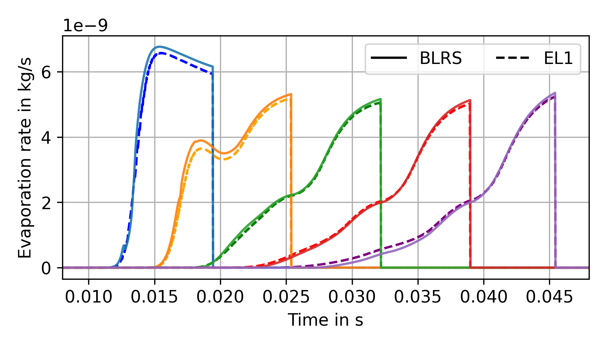
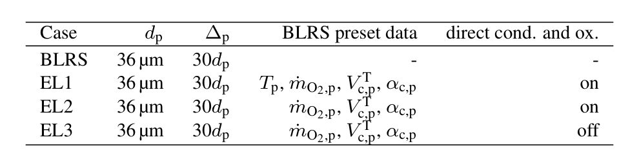
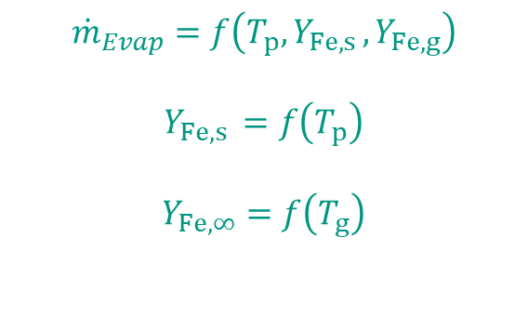
Comparison: Evaporation Rates from BLRS & EL
$${\dot{m}}_{Evap}=f\left(T_{p},Y_{Fe,s },Y_{Fe,g}\right)$$
$$Y_{Fe,s }=f\left(T_{p}\right)$$
$Y_{Fe,∞}=$ $f\left(T_{g}\right)$
Evaporation rates are nicely matched as long as the microparticle temperature is pre-set

Slide 9
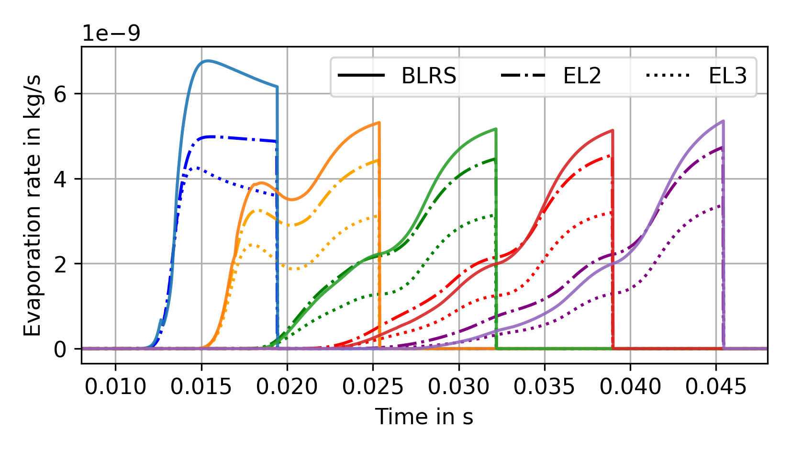



Comparison: Evaporation Rates from BLRS & EL Effect of the Nanoparticle Formation Model
One-step approach
${\dot{ω}}_{NP}=−{\dot{m}}_{Evap}\left(1−{\left.Y_{Fe,sat}\right|}_{T_{g}}\right)$ $\left(1+\frac{{0.5 M}_{O_{2}}}{M_{Fe}}\right)$
Collision rate as in BLRS
$${\dot{ω}}_{NP,ij}=γn_{i}n_{j}π\left(d_{i}+d_{j}\right)\sqrt{\frac{k_{B}T\left(m_{i}+m_{j}\right)}{2m_{i}m_{j}}}$$
The single-step condensation and oxidation model better matches the BLRS results.
$T_{p}$ includes${\dot{Q}}_{rad}, { \dot{Q}}_{reac}, {\dot{Q}}_{evap},{\dot{Q}}_{depo}$ and ${\dot{Q}}_{conv}$.

Slide 10

Open Challenges
How are mass and heat transport affected?
How to model the nanoparticle deposition?
Oxygen Consumption
Thermophoretic Velocity possibly via the Nusselt Number
Fe
Stefan Flow
Surface Velocity from Stefan Flow
Iron Evaporation
Fe
FeO
Nanoparticle Formation
FeO
$$T_{BL}↑$$
Do existing Nusselt and Sherwood correlations still work?
How to obtain the nanoparticle volume fraction at the surface?

Slide 11
We gratefully acknowledge the funding by the Friedrich-and-Elisabeth-Boysen Foundation under grant number BOY-195. We thank Bich-Diep Nguyen, Arne Scholtissek, and Christian Hasse (TU Darmstadt) for their support during development of the BLRS solver through the Clean Circles Project.

Slide 12
Appendix

Slide 13
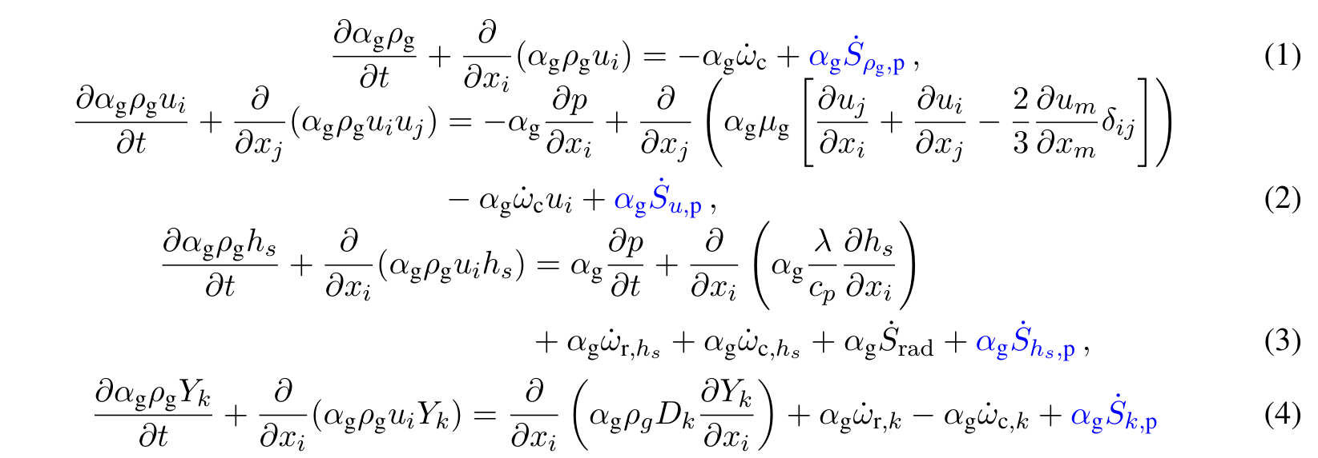
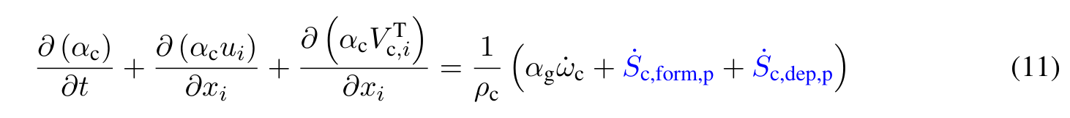
Governing Equations in the Eulerian Phases

Slide 14
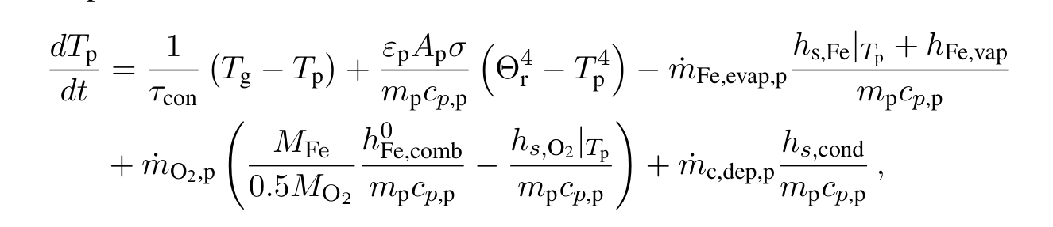
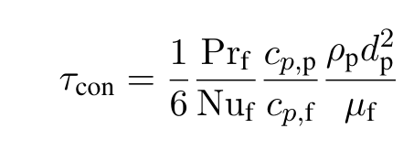
Particle Temperature in EL

Slide 15
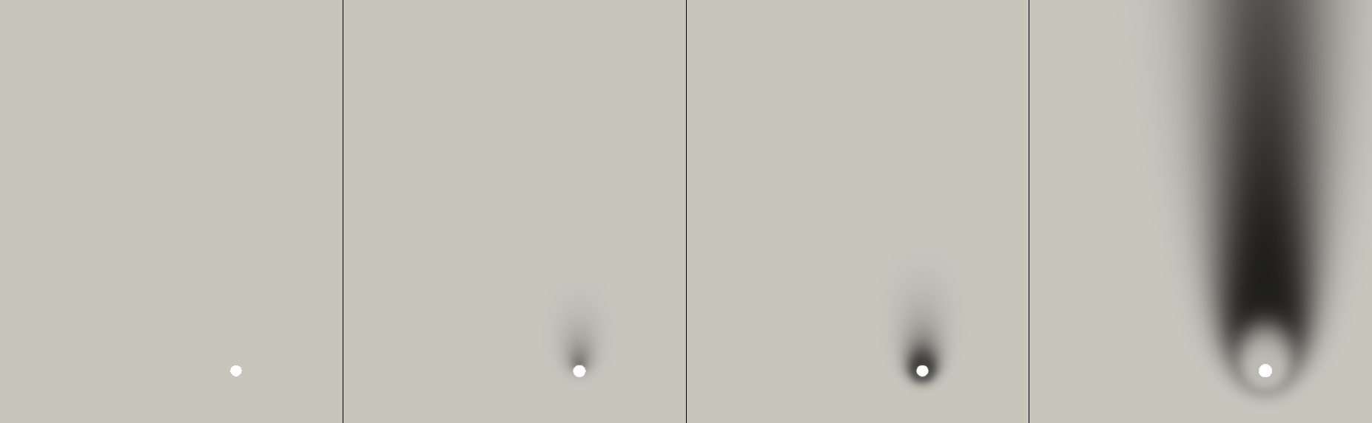
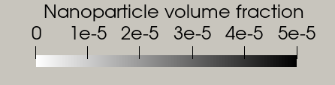
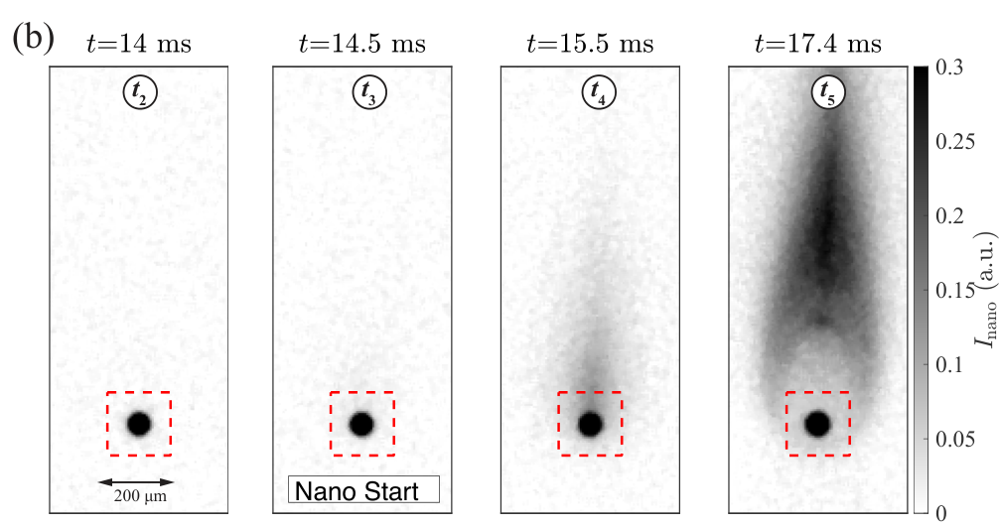
Comparison to experimental results
Experimental Images: Li, T., et al. (2026) Fuel 404: 136303.

Slide 16



Extension to multiple particles
$$Δ_{p}=20 d_{p}$$
$$d_{p}$$

Slide 17
Nanoparticle Formation: Evaporation Path
Deposition
Coalescence
Homogeneous Nucleation
Fe Nanodroplets
Condensation
Agglomeration
Evaporation
Fe(g)
Oxidation
O₂
Fe
Nanoparticles
Fe_{x}O_{y} Nanodroplets
Fe_{x}O_{y}
Microparticle
Phase Transition

Slide 18
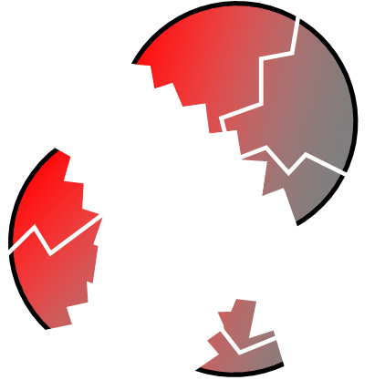
Nanoparticle Formation: Possible pathways
Evaporation Path
Microexplosion Path
Evaporation
O₂
O₂
Fe(g)
Fe
Fe_{x}O_{y}
Nanoparticle Formation by Condensation
Microexplosions
Oxidation, Phase Transition and Agglomeration
Nano Fragmentation

Slide 19

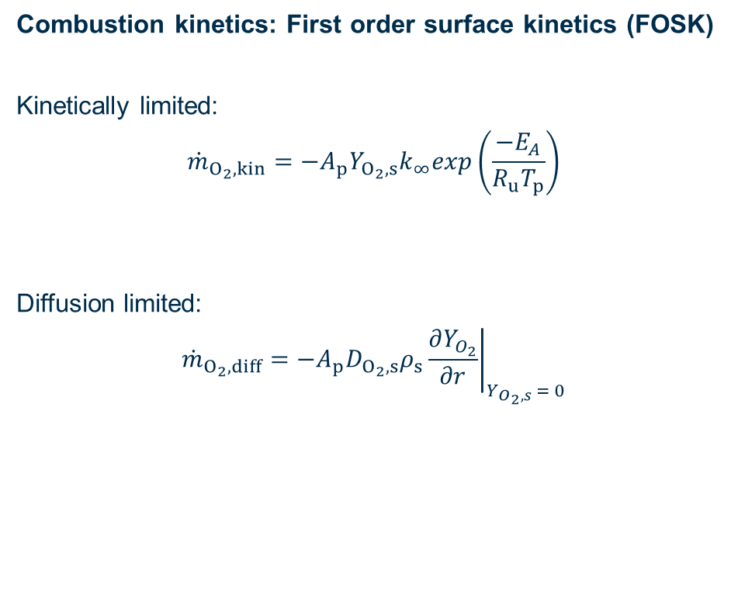
Setup and models
Combustion kinetics: First order surface kinetics (FOSK)
Kinetically limited:
$${\dot{m}}_{O_{2},kin}=−A_{p}Y_{O_{2},s}k_{∞}exp\left(\frac{−E_{A}}{R_{u}T_{p}}\right)$$
Diffusion limited:
$${\dot{m}}_{O_{2}, diff}=−A_{p}D_{O_{2},s}ρ_{s}{\left.\frac{∂Y_{O_{2}}}{∂r}\right|}_{Y_{O_{2},s} = 0}$$
Stefan Flow
$$u_{S}= \frac{\sum{\dot{m}}}{ρ_{s}A_{p}}$$
Thermophoresis
$$u_{T}=\frac{−3ν_{g}∇T}{4\left(1+\frac{0.9π}{8}\right)T}$$
[S1] Mich, J., et al. (2023) Combustion and Flame 256: 112949 [S2] Nguyen, B.-D., et al. (2025) Chemical Engineering Journal 507: 160039

Slide 20
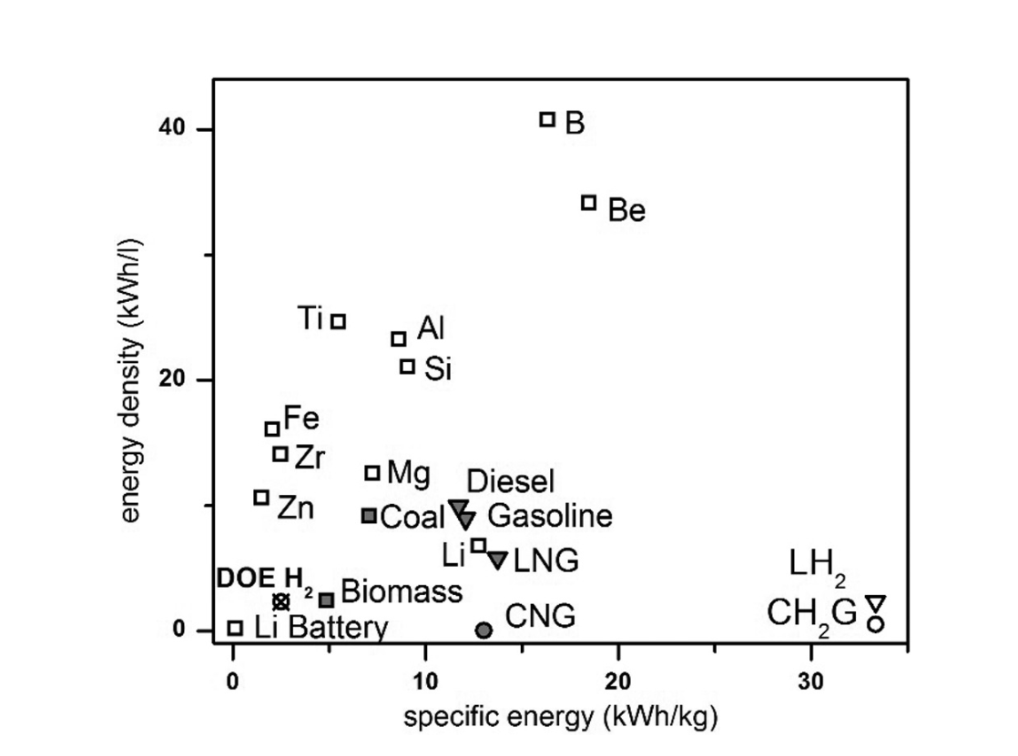
Energy density and specific energy
Bergthorson, J., et al. (2015) Applied Energy 160: 368-382

Slide 21


Metal fuels – An energy carrier in a global system
For Reference: 50 L Diesel (36 MJ/L) → ≈ 1000 km
$≙$ 100 km
LH2: 8,5 MJ/L → 236 km
LNG: 22 MJ/L → 610 km
Iron: 58 MJ/L → 1610 km
Sadeghinezhad, E., et al. (2013) Renewable and Sustainable Energy Reviews 28: 410-424; Alkhaledi, A. N., et al. (2022) Ships and Offshore Structures 17(7): 1555-1564; Boretti, A. (2020) Applied Sciences 10; Fischer, S. H. and Grubelich, M. (1998) Sandia National Lab.(SNL-NM), Albuquerque, NM.

Slide 22
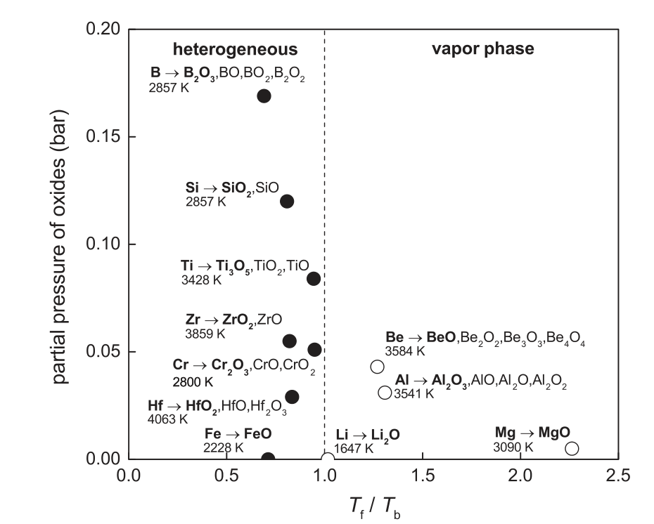
Burning modes
Bergthorson, J., et al. (2015) Applied Energy 160: 368-382

Slide 23
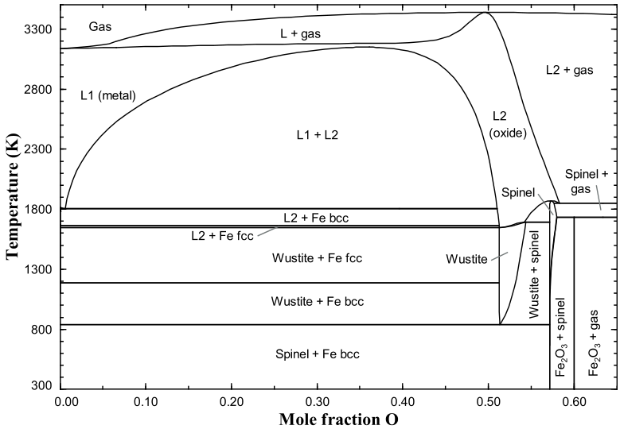
Phase diagram
Thijs, L.C., et al. (2025) Combustion and Flame 271: 11382

Slide 24
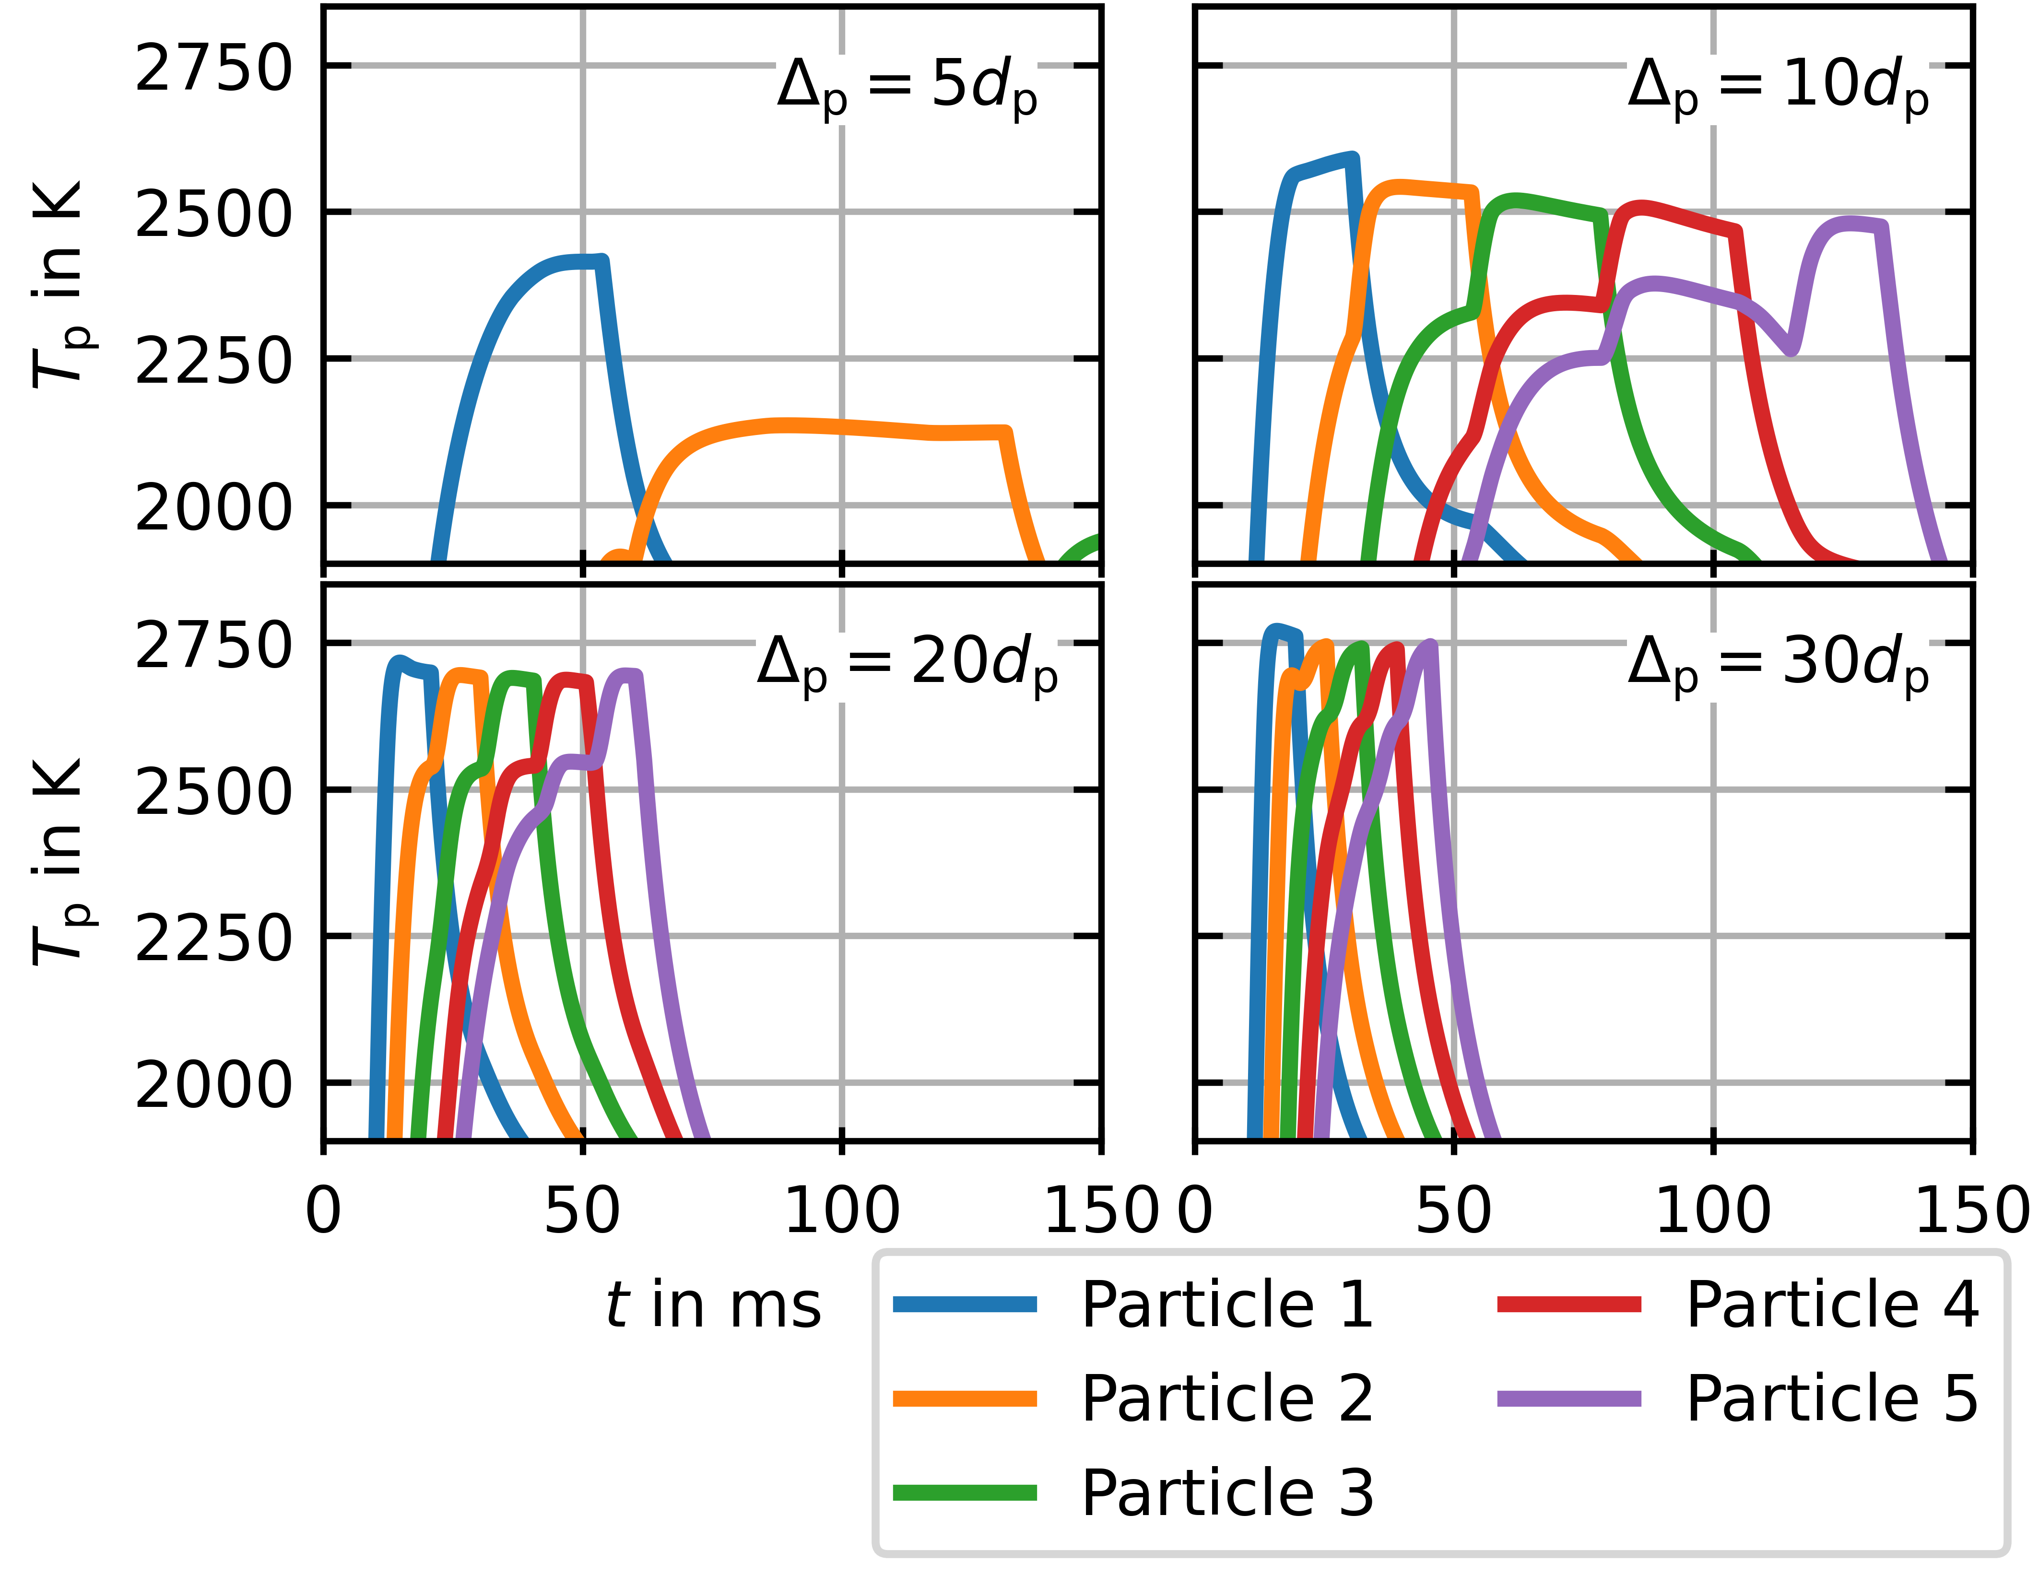
Temporal temperature development: array
d_{p} = 36 µm

Slide 25
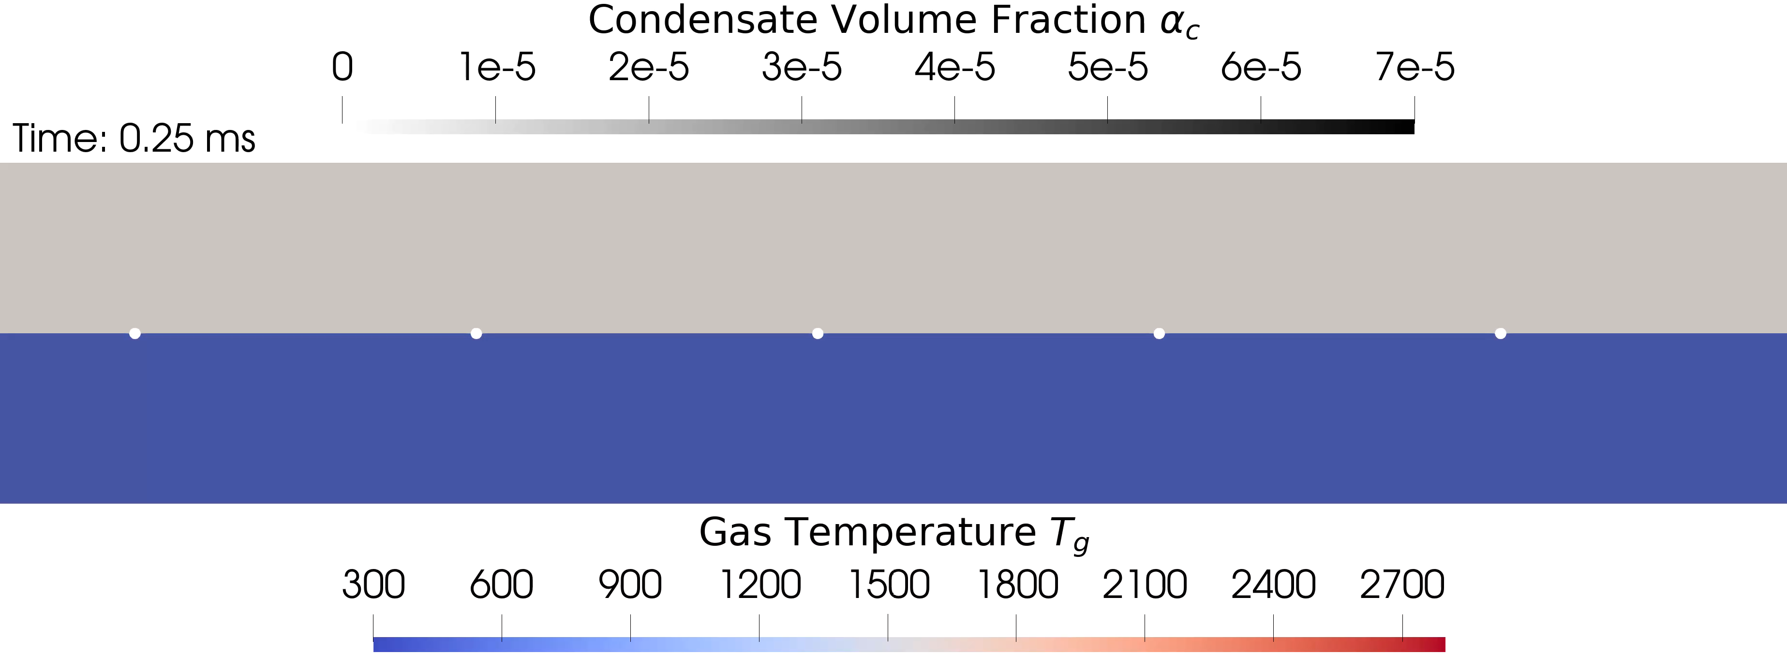


Boundary Layer Resolved Simulation
Video BLRS Multiparticle
$$Δ_{p}=30 d_{p,0}$$
Euler-Lagrange Cell Size
$$d_{p,0}=36 μm$$
Hot Air
(1800 K, 0.5 m/s)

Slide 26
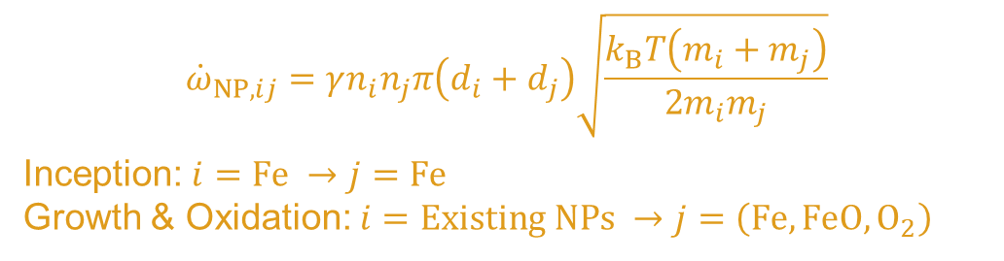

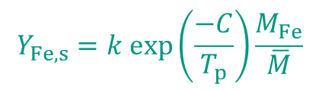
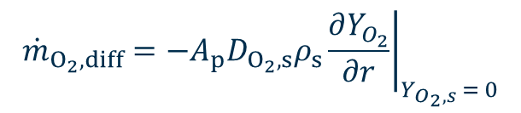
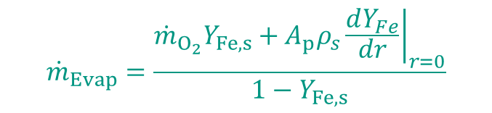
Modelling: Microparticle Oxidation and Nanoparticle Formation
$$d_{p}$$
$${\dot{m}}_{Evap}=\frac{{\dot{m}}_{O_{2}}Y_{Fe,s}+A_{p}ρ_{s}{\left.\frac{dY_{Fe}}{dr}\right|}_{r=0}}{1−Y_{Fe,s}}$$
$${\dot{m}}_{O_{2},kin}=−A_{p}Y_{O_{2},s}k_{∞}exp\left(\frac{−E_{A}}{R_{u}T_{p}}\right)$$
$$d_{p,0}$$
O₂
Evaporation
$$Y_{Fe,s}=k exp⁡\left(\frac{−C}{T_{p}}\right)\frac{M_{Fe}}{\overline{M}}$$
Fe
Fe
Fe
Fe(g)
FeO
Nanoparticle Transport
FeO
$${\dot{m}}_{O_{2}, diff}=−A_{p}D_{O_{2},s}ρ_{s}{\left.\frac{∂Y_{O_{2}}}{∂r}\right|}_{Y_{O_{2},s} = 0}$$
Advection
Mass Diffusion
Thermophoresis
$${\dot{ω}}_{NP,ij}=γn_{i}n_{j}π\left(d_{i}+d_{j}\right)\sqrt{\frac{k_{B}T\left(m_{i}+m_{j}\right)}{2m_{i}m_{j}}}$$
Inception: $i=Fe →j=Fe$
Growth & Oxidation: $i=Existing NPs →j=\left(Fe, FeO, O_{2}\right)$
Nanoparticle Formation
[4] Mich, J., et al. (2023) Combustion and Flame 256: 112949 [5] Nguyen, B.-D., et al. (2025) Chemical Engineering Journal 507: 160039

Slide 27
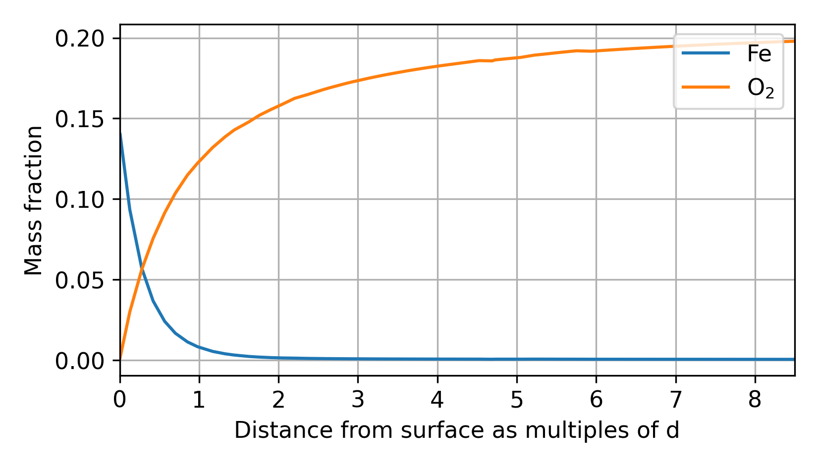
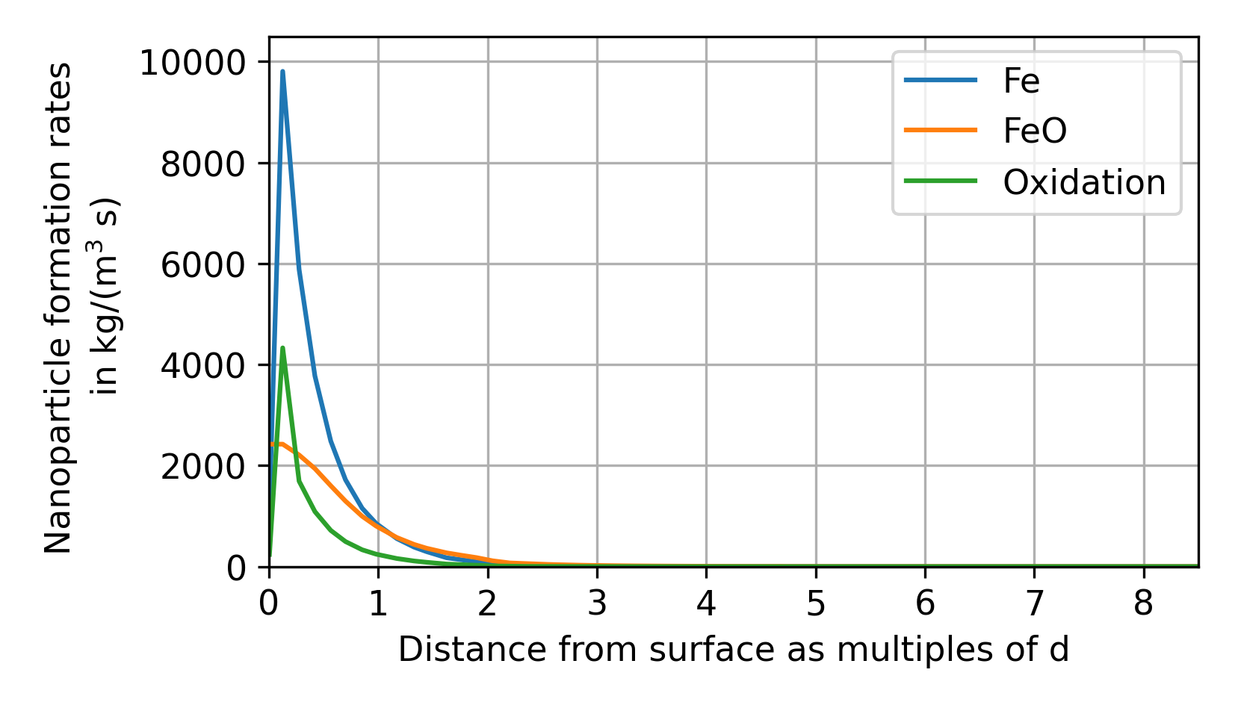
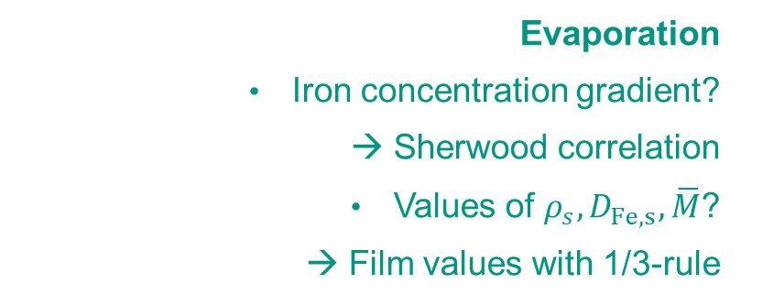
Modelling Boundary Layer Processes: Evaporation and Nanoparticle Formation
Boundary Layer Resolved
Euler-Lagrange
Cell values are known, surface values require modelling
Evaporation
Iron concentration gradient?
→ Sherwood correlation
Values of $ρ_{s},D_{Fe,s},\overline{M}$?
→ Film values with 1/3-rule
?
✓
Fe
FeO
Nanoparticle Formation
Primarily happens close to the particle surface
Effect of heat release from condensation and oxidation in the boundary layer?

Slide 28
Open Challenges
Oxygen Consumption
How are mass and heat transport affected by
Nanoparticle formation in the BL
Co-flowing iron and oxygen streams in the BL (especially at high ambient temperatures)
Do existing Nusselt and Sherwood correlations still work?
How to model the deposition of nanoparticles
Stefan velocity at the surface ✓
Thermophoretic velocity possibly obtainable from Nusselt number
Nanoparticle volume fraction at microparticle surface
Fe
Stefan flow
FeO
Iron Evaporation

